Slide 1

Automated Mobile Development & Testing Platform Integration BrowserStack
Project Proposal – IT Division
Date: July. 2025

Slide 2
AGENDA
Overview/ Problem Statement
Solution
Demo
Conclusion
Q&A

Slide 3


PROPOSAL OVERVIEW
Problem Statement:
Manual testing for mobile applications presents several critical challenges as our product sales:
Inefficiencies in Manual Testing:
Time-consuming: High effort is require to repeatedly execute test cases.
Error prone: Prone to human errors and inconsistency in result
Limited Test Coverage
Lacks scalability across platform (iOS & Android)
Inadequate coverage of real-world device and OS version
Lack of Modern DevOps Practices
No CI/CD integration for automated feedback loops
Objective & Goals
Ensure Quality & Efficiency
Improve Product quality by catching regression early
Reduce manual testing effort and cost
Enable Agile & CI/CD Readiness
Accelerate feedback loops through CI/CD integration
Ensure faster releases with Automated testing piplines
Leverage Best Practices
Adopt BDD (Behavior Driven Development) for human-readable and extensible test scripts
Integrate Serenity BDD to manage test scenarios and generate report
Integrated Apium: for execution test across iOS and Android and multiple environments

Slide 4
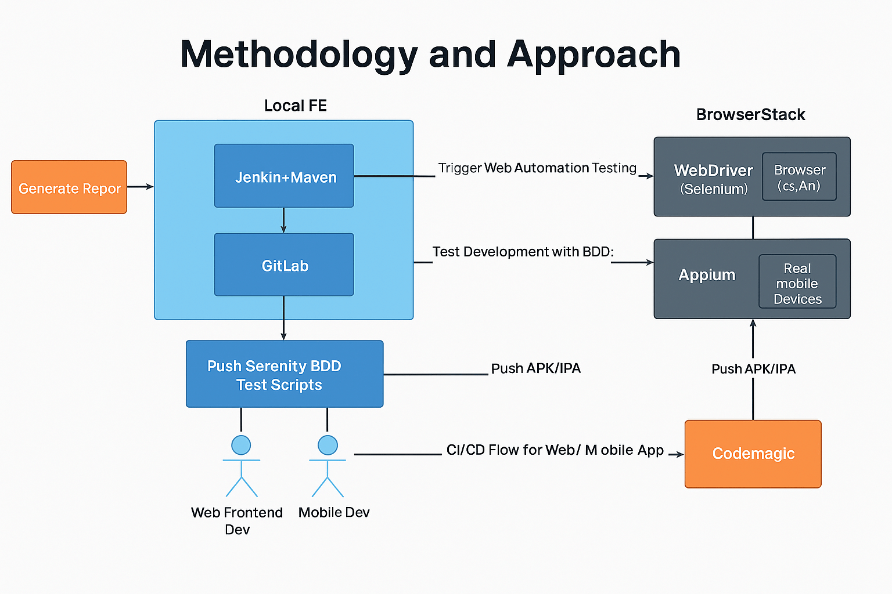
SOLUTION OVERVIEW

Slide 5
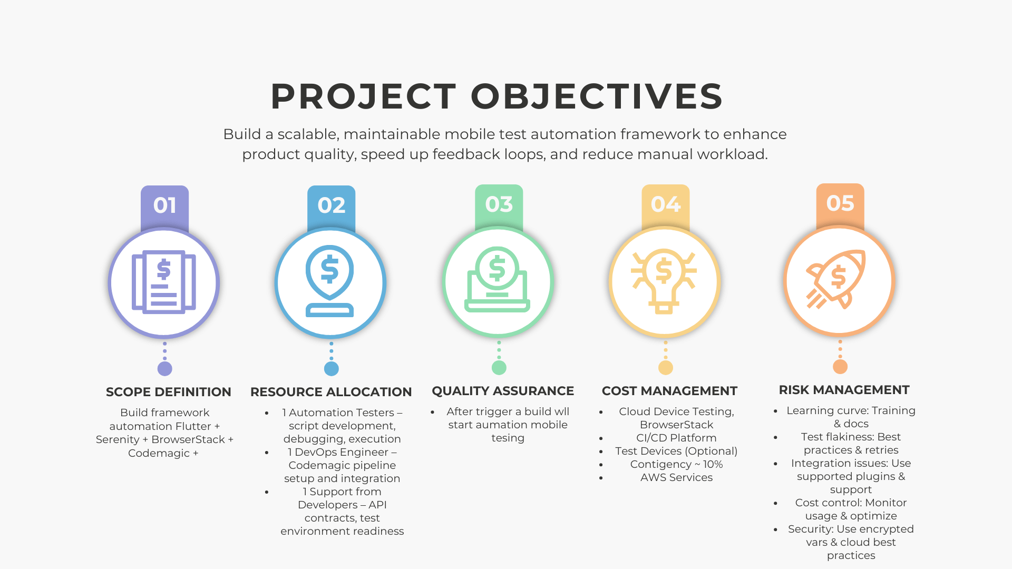
OBJECTIVES

Slide 6
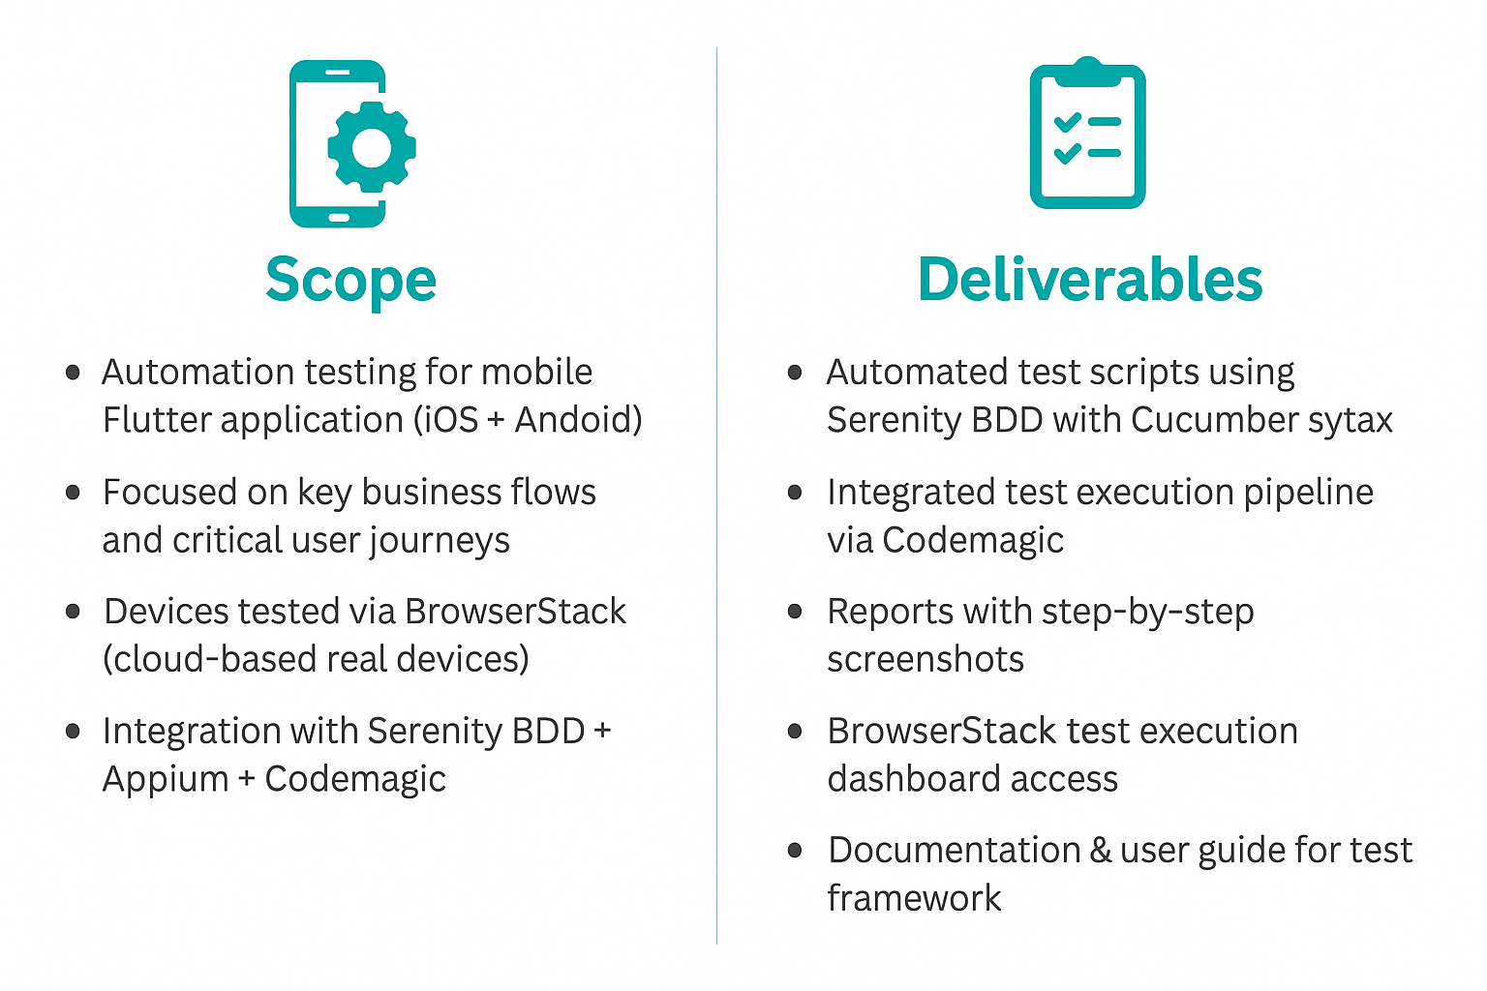
SCOPE AND DELIVERABLES

Slide 7
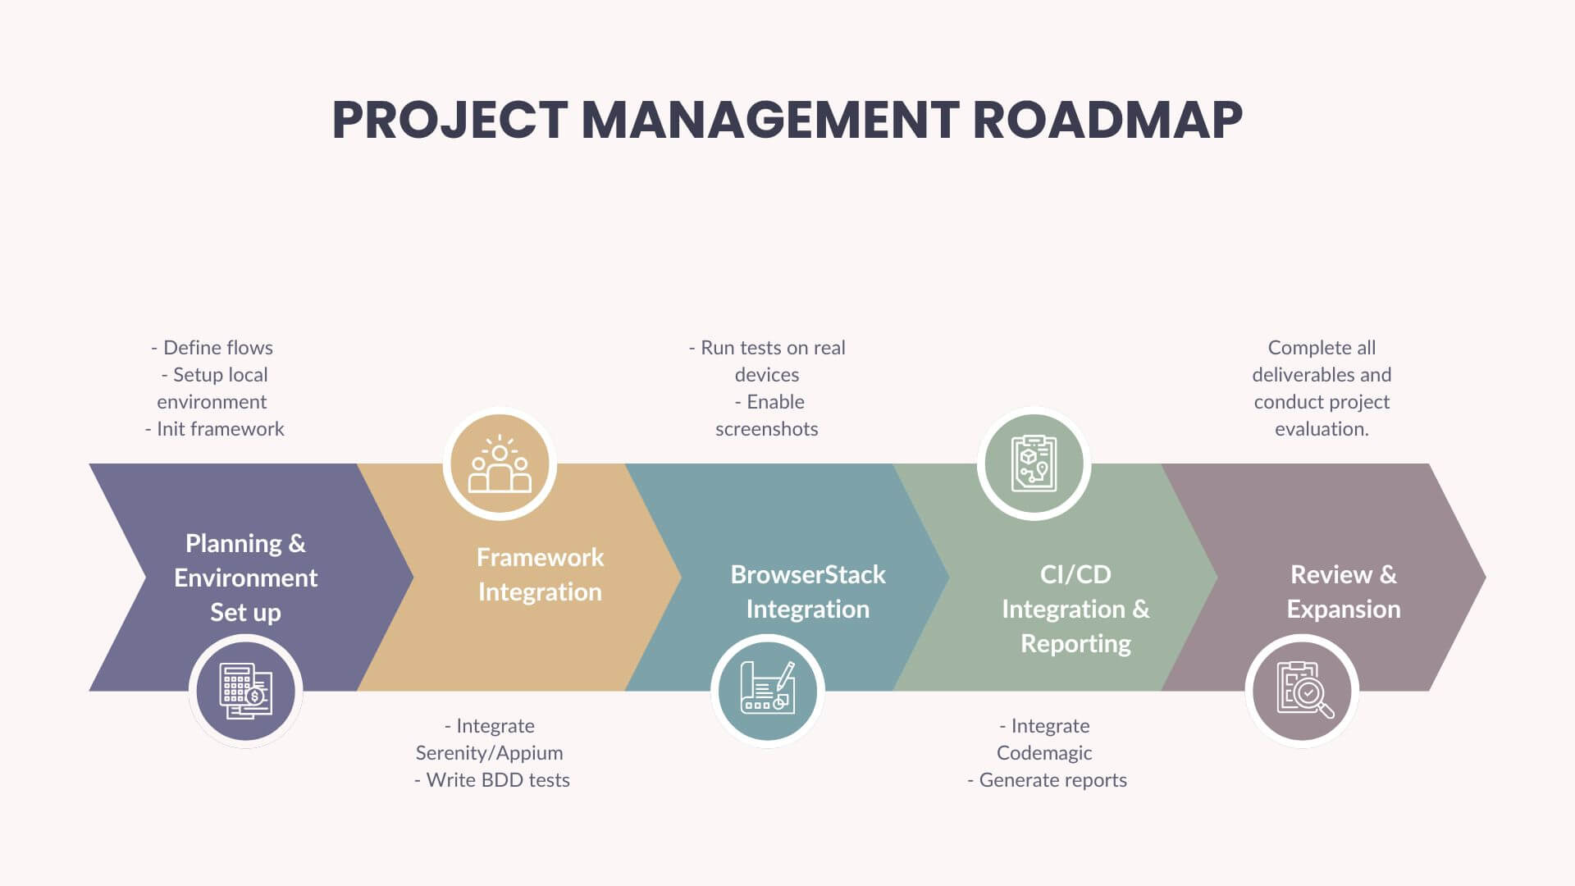

IMPLEMENTATION PLAN

Slide 8
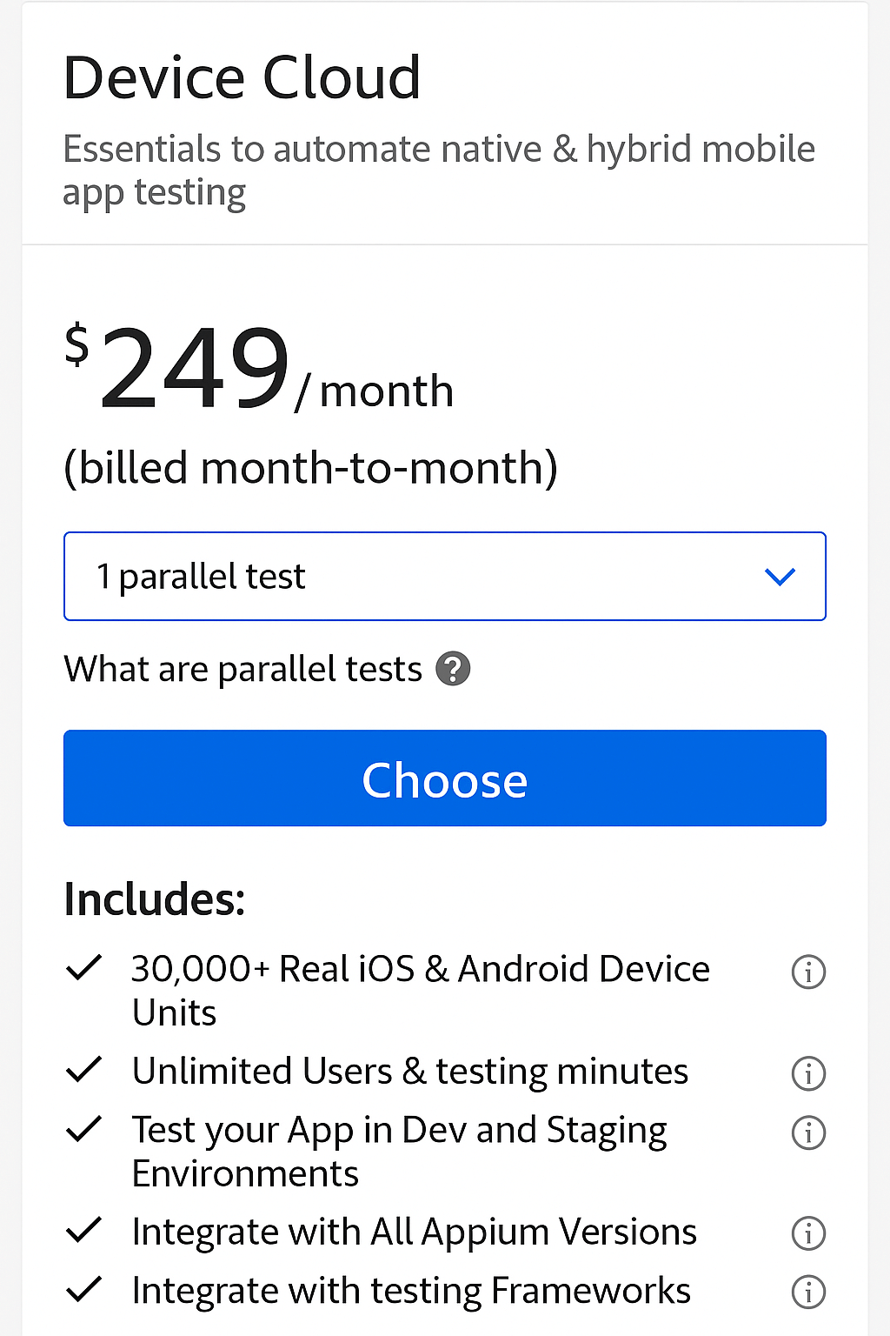
COST BROWSERSTACK

Slide 9
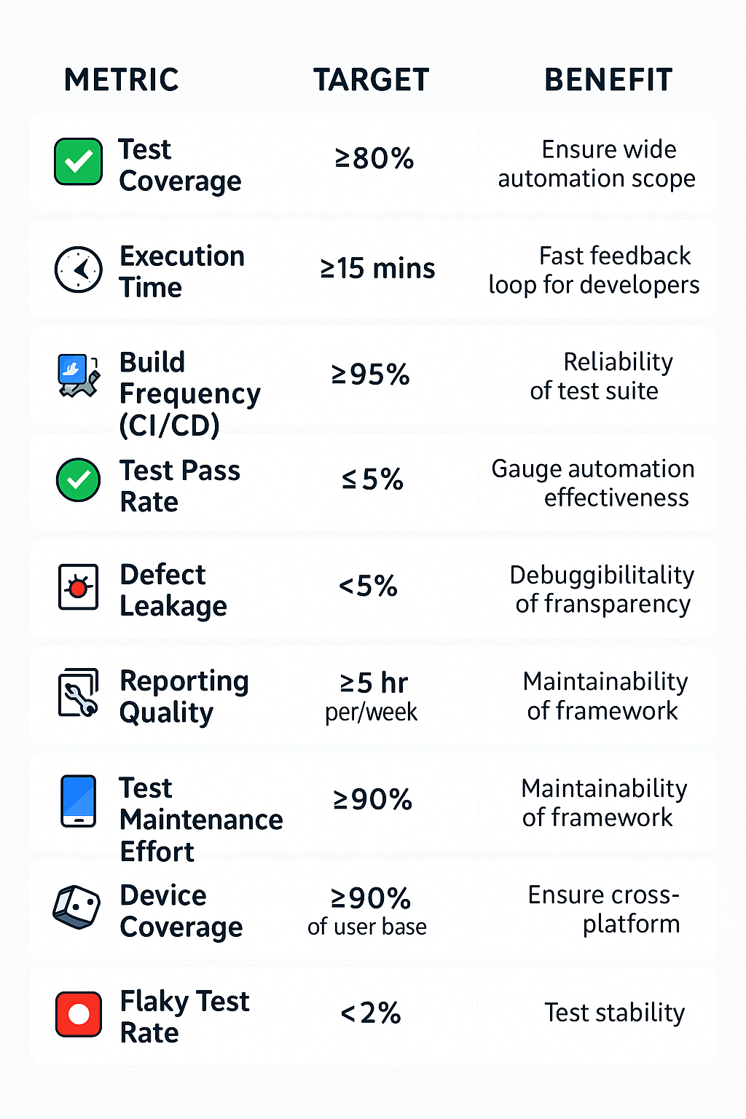
QUALITY METRICS

Slide 10
DEMO SCENARIO
1. User Story:
As an iCollect user, I want to log in successfully with valid credentials so that I can access the dashboard page on 2 devices iOS and Android
2. Test Scenario (Serenity BDD + JUnit/Cucumber)
Feature: Login Functionality
Scenario 1: Successful login with valid credentials
Given user opens iCollect login page
When user enters valid username and password
And clicks Login button
Then system should display dashboard
Scenario 2: Unsuccessful login with invalid credentials
Given user opens iCollect login page
When user enters wrong password
And clicks Login button
Then system should show error message

Slide 11
DEMO PREPARATION
3.Execution on BrowserStack Android: webdriver {driver = remote} webdriver.remote.url = "https://hub-cloud.browserstack.com/wd/hub" browserstack { user = "YOUR_BROWSERSTACK_USERNAME" key = "YOUR_BROWSERSTACK_ACCESS_KEY" } | # Example capability browserstack.capabilities = { "platformName": "Android", "deviceName": "Google Pixel 7", "platformVersion": "13.0", "app": "bs://<app-id>", "bstack:options": { "projectName": "iCollect", "buildName": "iCollect-Mobile-Demo", "sessionName": "iCollect Login Test - Android", "appiumVersion": "2.5.1", "networkLogs": true, "deviceLogs": true } }

Slide 12
DEMO SCENARIO iOS
4.Execution on BrowserStack iOS: # Example capability browserstack.capabilities = { "platformName": "iOS", "deviceName": "iPhone 14", "platformVersion": "16", "app": "bs://<app-id>", | "bstack:options": { "projectName": "iCollect", "buildName": "iCollect-Mobile-Demo", "sessionName": "iCollect Login Test - iOS", "appiumVersion": "2.5.1", "networkLogs": true, "deviceLogs": true } }

Slide 13
DEMO REPORTING
5. Serenity BDD Reporting:
After running:
Serenity generates an HTML report in the target/site/serenity/ directory.
The report includes:
Overview of test pass/fail.
Details of each step Given/When/Then.
Automatic screenshot (capture can be enabled).
BrowserStack session link (to view video replay of test run).

Slide 14
DEMO FLOW
Developer pushes test to GitLab/GitHub.CI/CD pipeline triggers test execution with Maven/Gradle.
Test suite runs on BrowserStack (multi-browser, multi-device).
Results are returned and Serenity build report is reported.
Report link is generated to QA team for review.

Slide 15
DEMO
Serenity BDD Reporting:
After running:
Serenity generates an HTML report in the target/site/serenity/ directory.
The report includes:
Overview of test pass/fail.
Details of each step Given/When/Then.
Automatic screenshot (capture can be enabled).
BrowserStack session link (to view video replay of test run).

Slide 16
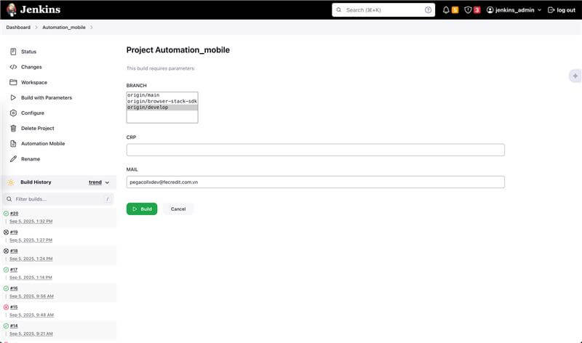
JENSKIN CI/CD

Slide 17
BROWSERSTACK OVERVIEW
Device | OS | Resolution | Chipset | Link
Samsung Galaxy S21 | Anroid 14 | 1080x2400 | Exynos 2100
Samsung Galaxy A53 | Android 13 | 1080x2400 | Exynos 1280
Google Pixel 6 | Android 14 | 1080x2400 | Tensor | https://app-automate.browserstack.com/dashboard/v2/public-build/MGJrbUZ3NndKYnlKUjBRSm1Ib0hSWFk0S01TT3dNbTFTS3FiSkM3S2dPVm9vdFNoQ3B3T0EvQ2dUckM0U2laZG5oOEtXbFhmZDNXL1FzYndqSGVPY2c9PS0tT3cwZG5lYkZidjdGbFNsdWNkQjJpUT09--6353c0150a69498232bc1f29c012d59b0820ee32
Xiaomi Redmi Note 11 | Android 11 | 1080x2400 | Snapdragon 685 | https://app-automate.browserstack.com/dashboard/v2/public-build/Q3pjZi9XSklIalg3K2tvNlhjRjQ1VnVLY1pCT2hCbzhGSXNwVlkyQVVXenh1ZWxmRTdzT0dobDRZalkrOU1ZaDZjL09VcXNIZFowRm0yWlJqSFZrNUE9PS0tc3JJOElKbEhmcTFuV2d1Vk53S3ViZz09--7c0bdf2234b6e35fca8c97f828da01c05c3c8c28
iPhone 13 | iOS 18 | 1170x2532 | A15 | https://app-automate.browserstack.com/dashboard/v2/public-build/eDNpcXhQQ1Q2bm9LVGVSd3FMWnp3c3NWZTBtdGI1TXdTY1ExUTQxUVpjNEt3MUIrM3B0TGxpdFVjT2dxcitRMU9ZeXFIaGpURnRBOXk3ZVEvR3NIc3c9PS0tck1TQldkMDBHWDBScGFCd1RVLy96dz09--5bdbeb26c35c642d264be7d52d4c9194a937f3ac
iPhone 14 | iOS 18 | 1170x2532 | A15
iPhone SE (3rd gen) | iOS 17 | 750x1334 | A15
iPhone 15 | iOS 18 | 1179x2556 | A16

Slide 18
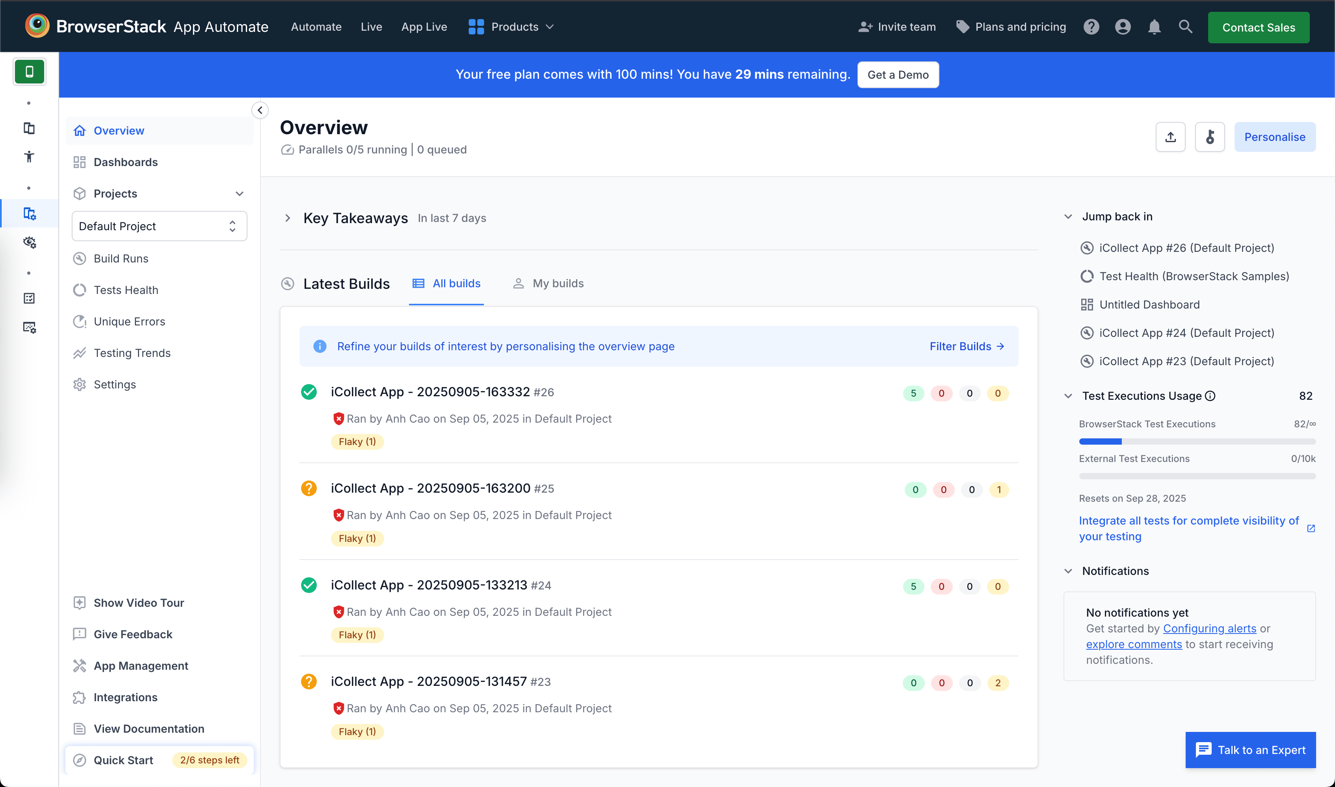
BROWSERSTACK OVERVIEW
https://app-automate.browserstack.com/dashboard/v2/public-build/Q3pjZi9XSklIalg3K2tvNlhjRjQ1VnVLY1pCT2hCbzhGSXNwVlkyQVVXenh1ZWxmRTdzT0dobDRZalkrOU1ZaDZjL09VcXNIZFowRm0yWlJqSFZrNUE9PS0tc3JJOElKbEhmcTFuV2d1Vk53S3ViZz09--7c0bdf2234b6e35fca8c97f828da01c05c3c8c28

Slide 19
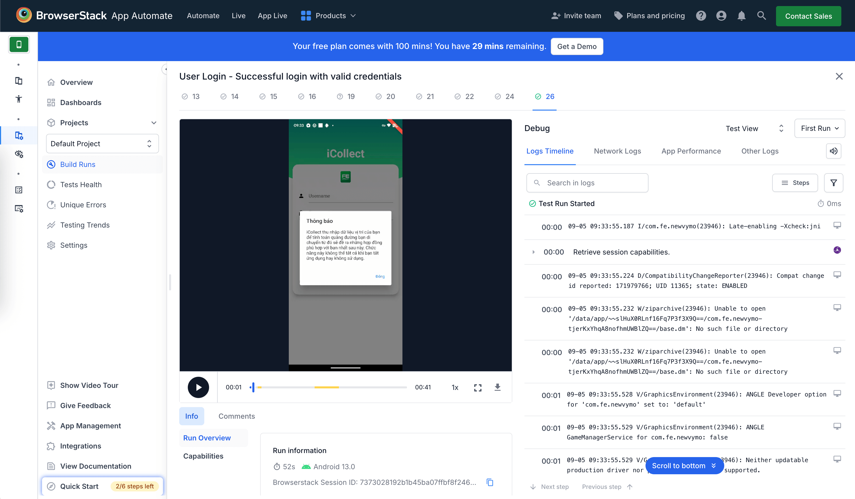
BROWSERSTACK BUILD RUN

Slide 20
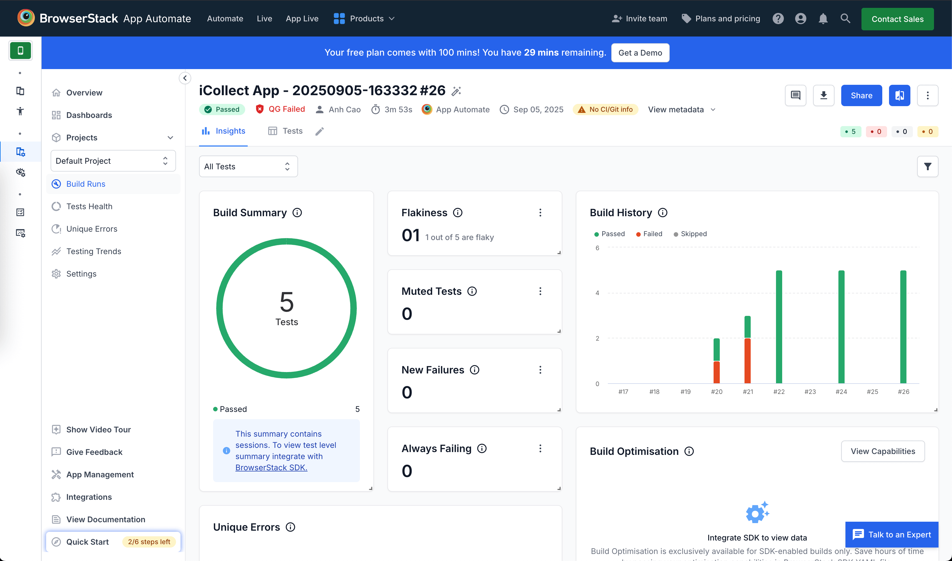
BROWSERSTACK BUILD SUMMARY

Slide 21
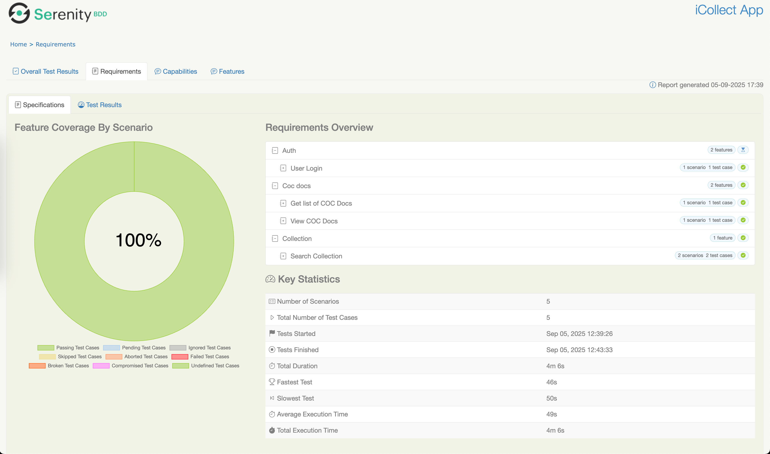
SERENITY TEST SUIT
Test scripts:

Slide 22
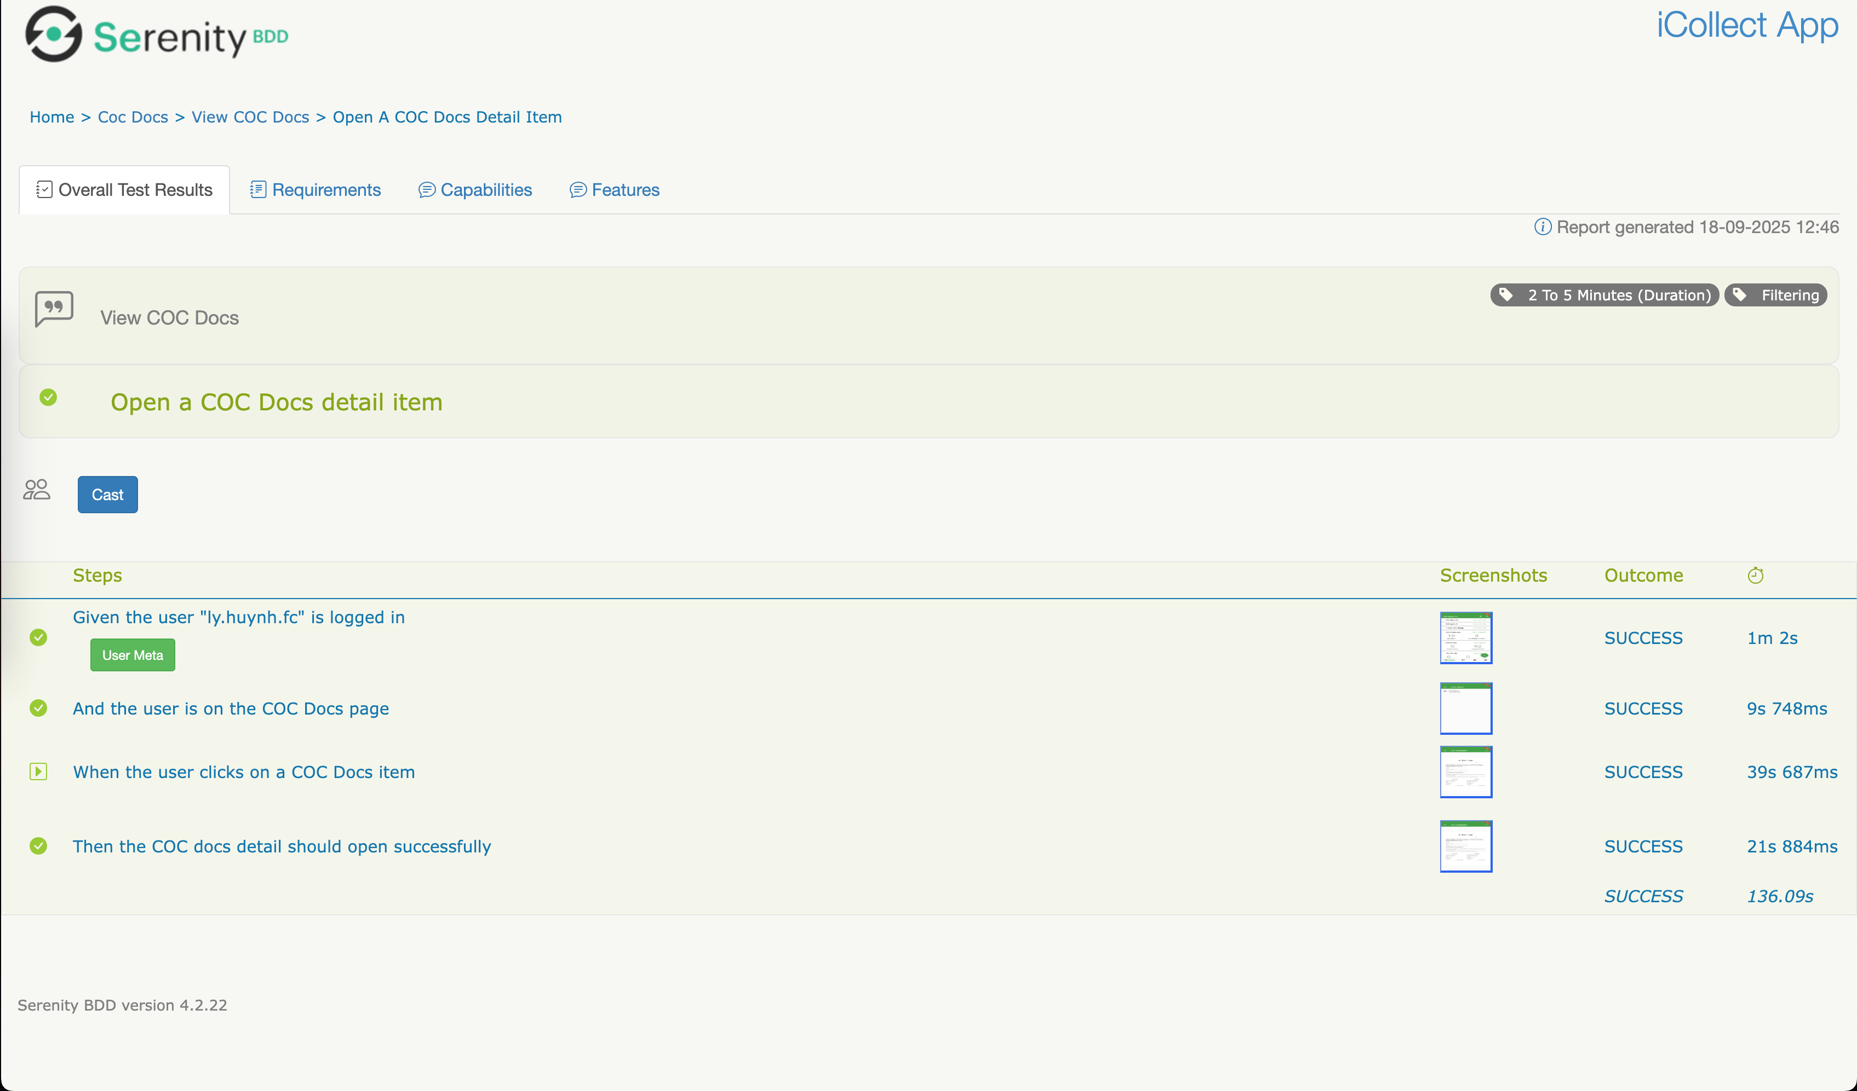
SERENITY TEST SUIT DETAIL

Slide 23
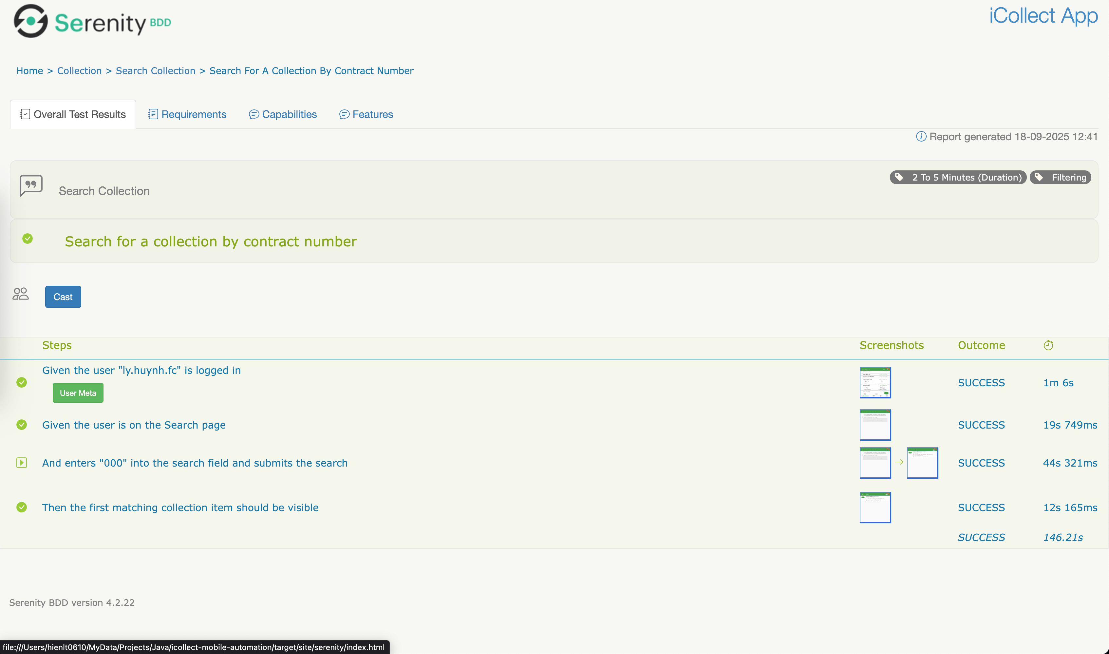
SERENITY TEST SUIT DETAIL

Slide 24
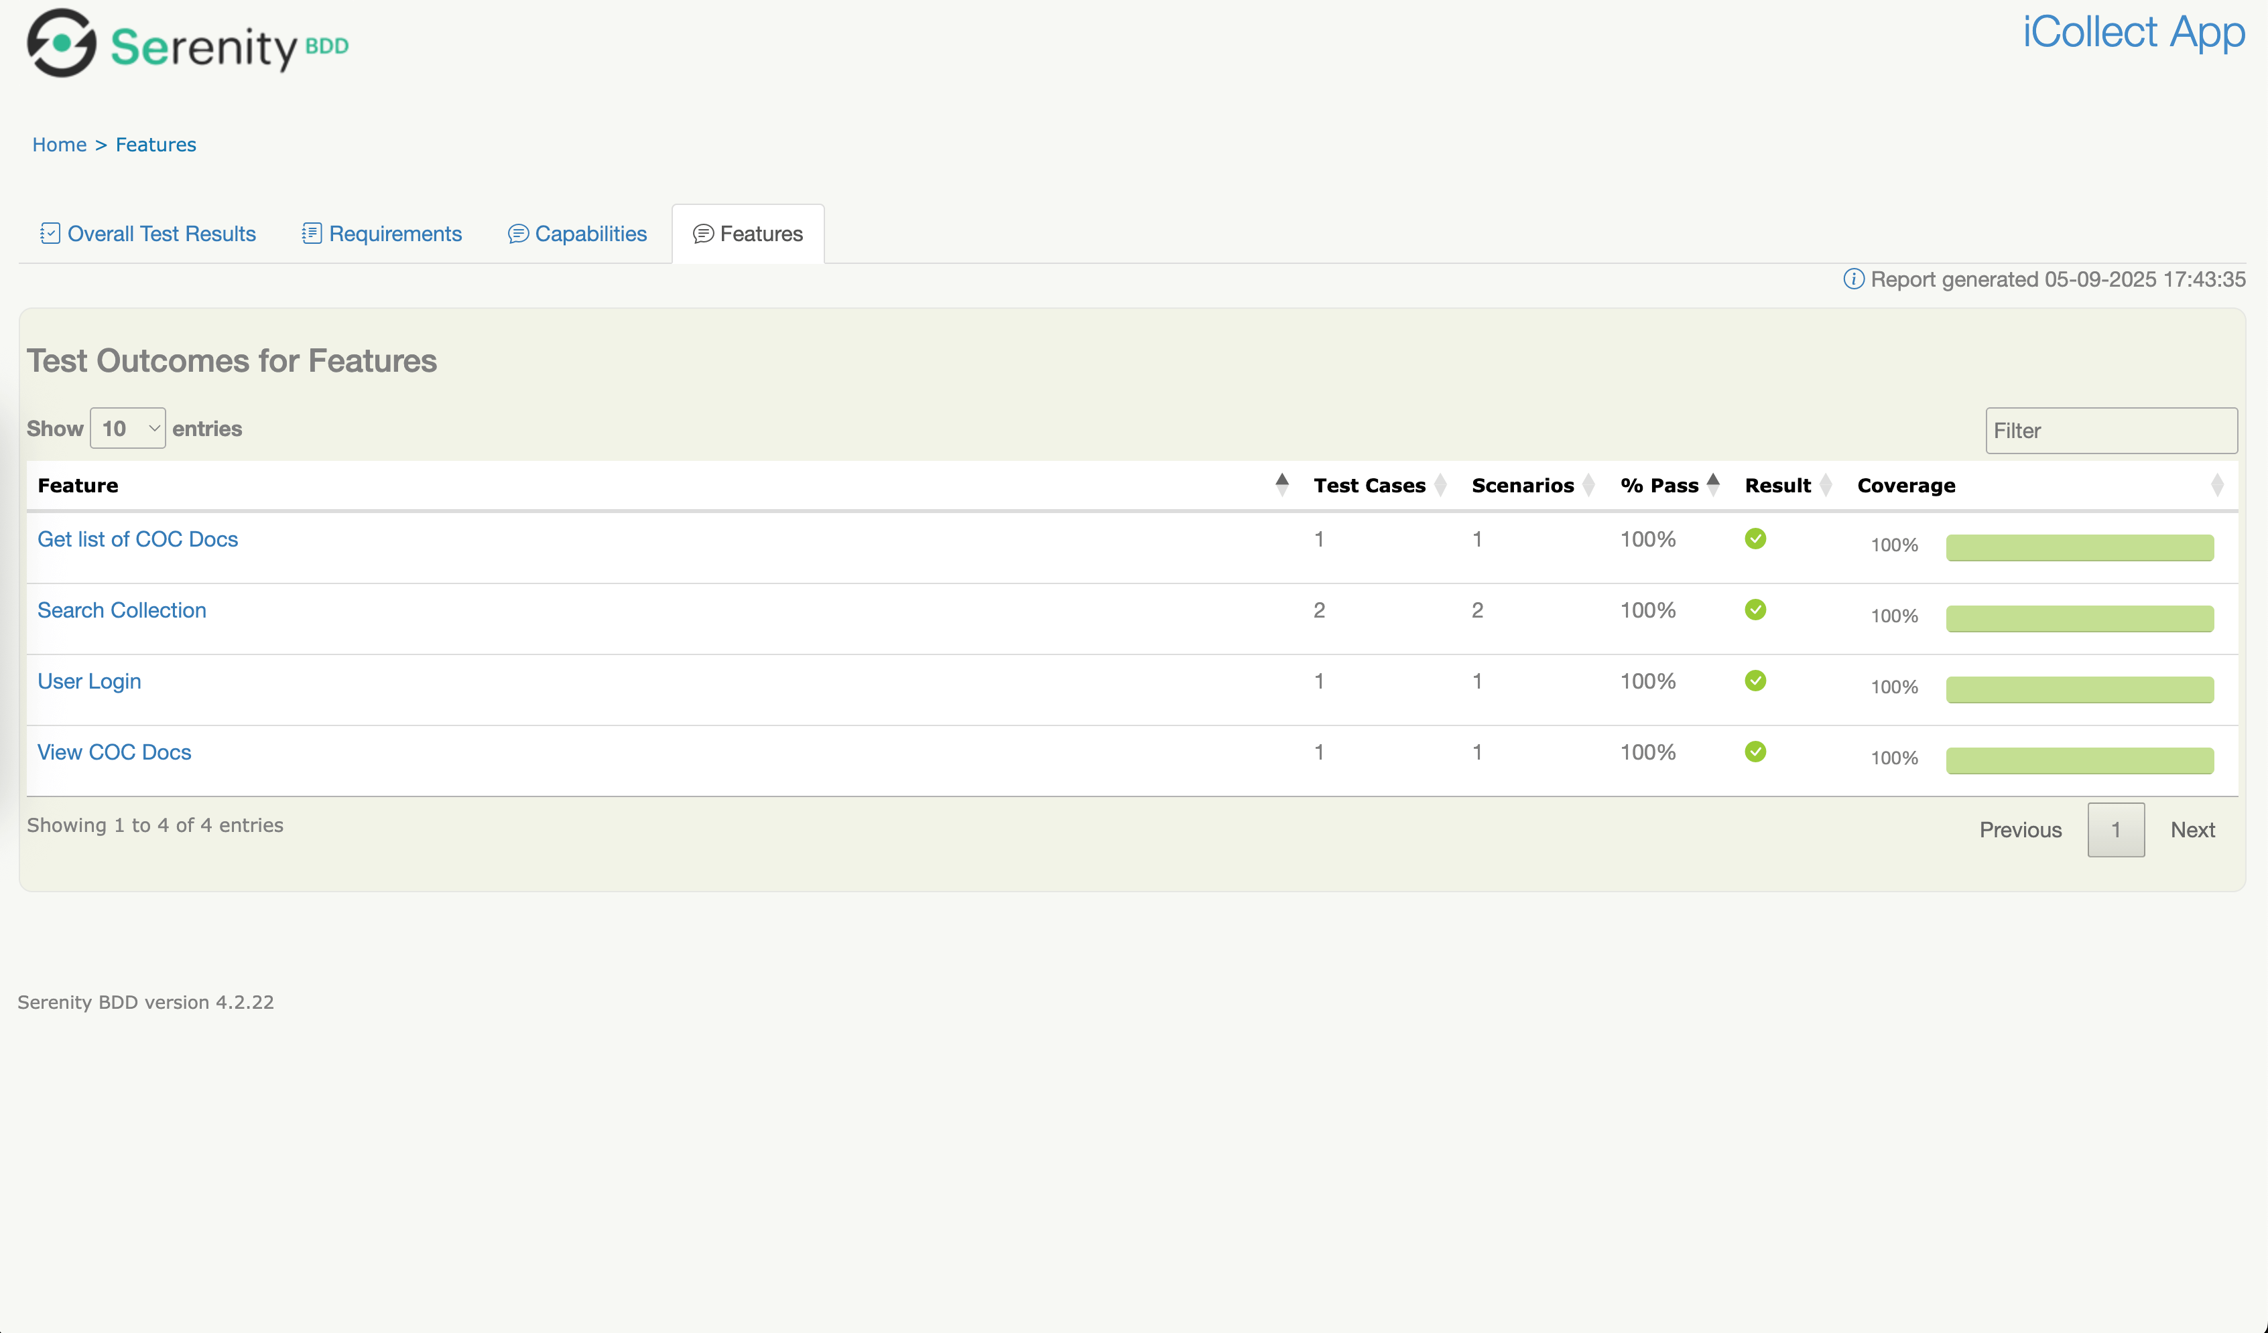
SERENITY TEST OUTCOME
Automation Report: http://opsched.deltavn.vn:8014/automation/mobile/origin/develop/

Slide 25
Q&A

